Slide 1
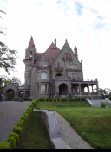
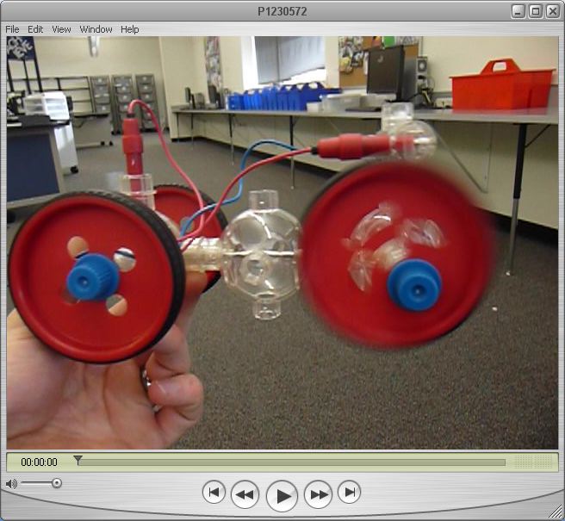
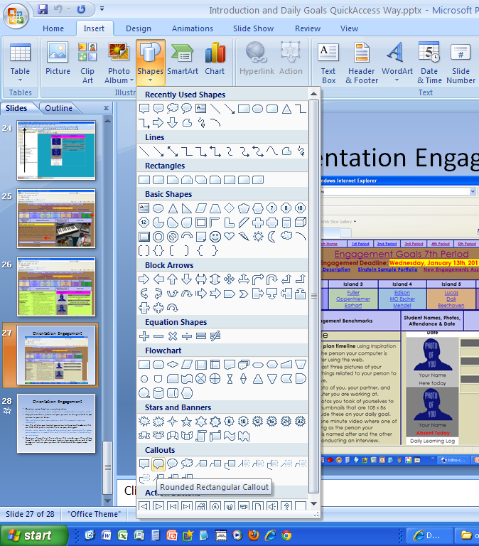
Documenting Your Work
Show us How you did it!

Slide 2
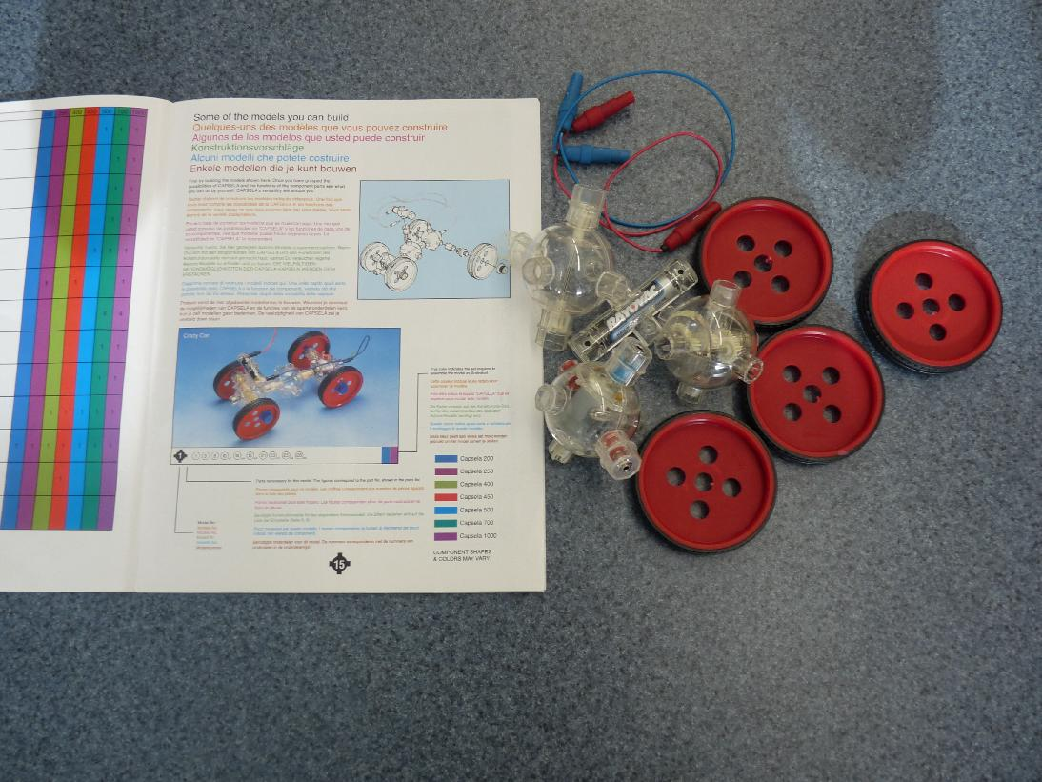
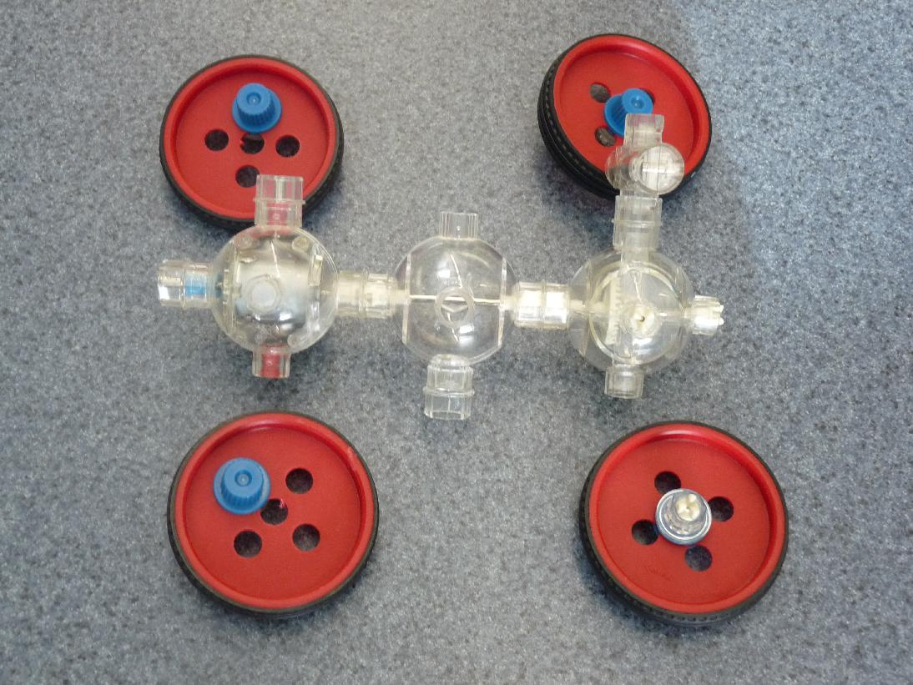
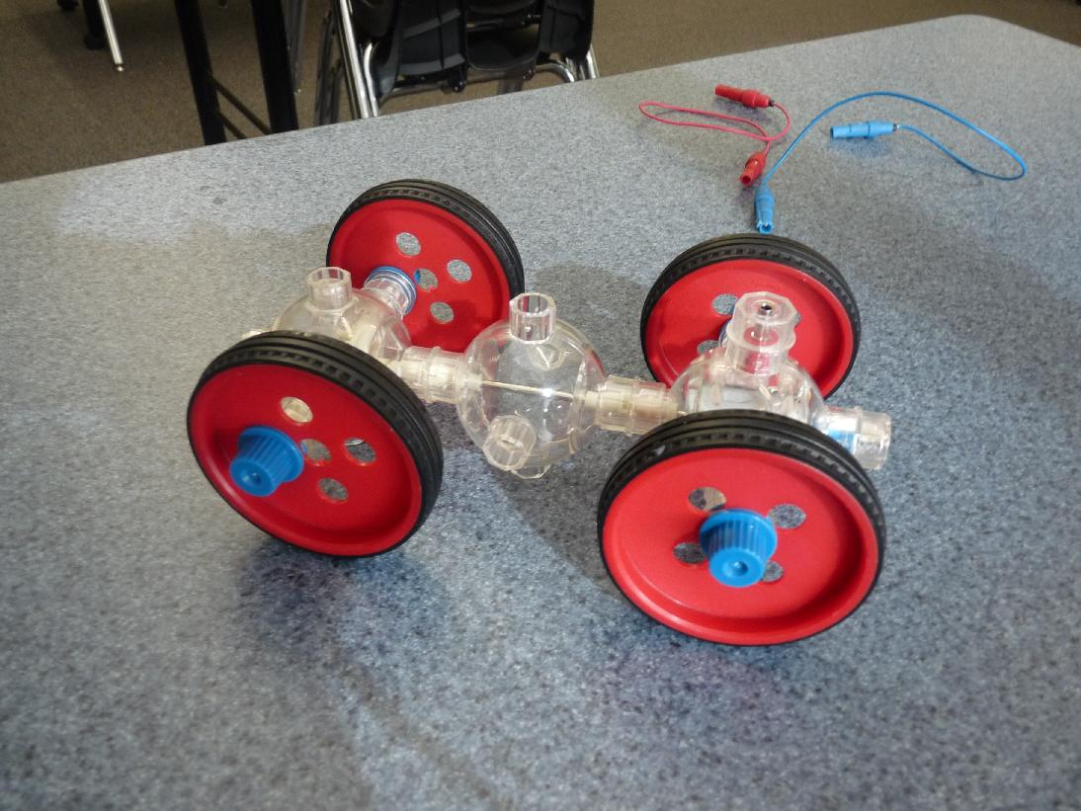
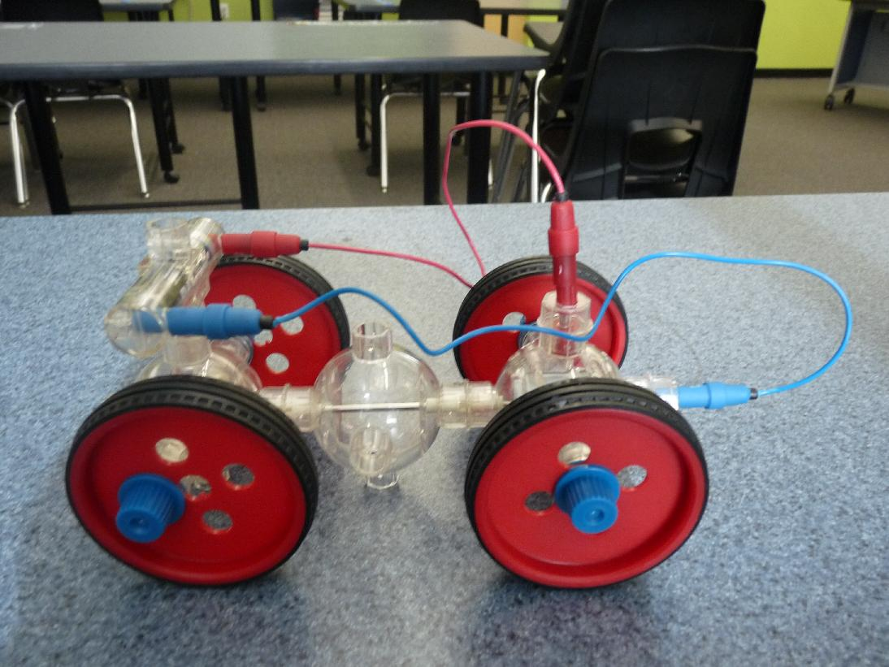
Documenting your work with Photos
Use photos and callouts to explain the process.
Tell us about the steps you took to reach the finished product

Slide 3
Using Video Clips
Open your video by double clicking on the .MOV file.
Use “Alt + PrtScn” to take a screen capture of the video player.
Paste the Screen Capture into your PowerPoint slide.

Slide 4
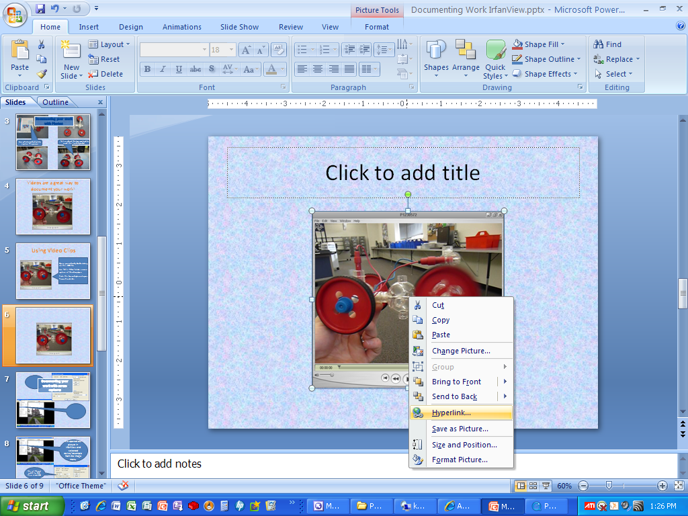
Adjust the size and position of the screen capture
Right click on the screen capture and select hyperlink
Hyperlink the video to the .MOV file in your LEARNERS DRIVE!!!

Slide 5
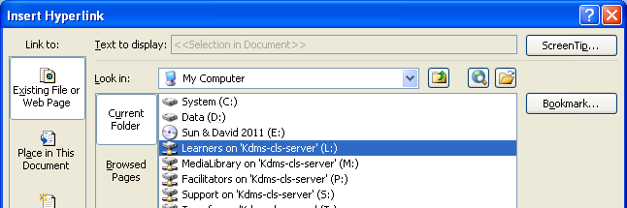
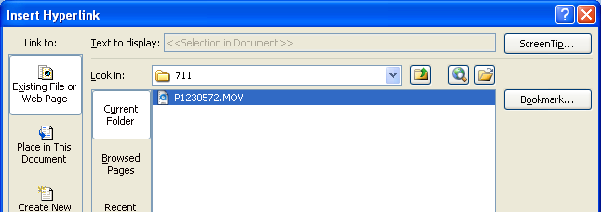
Learners Drive
Learners Drive

Slide 6
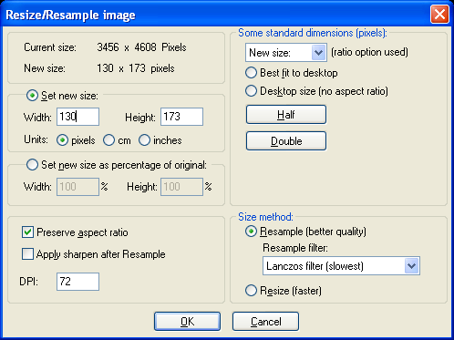
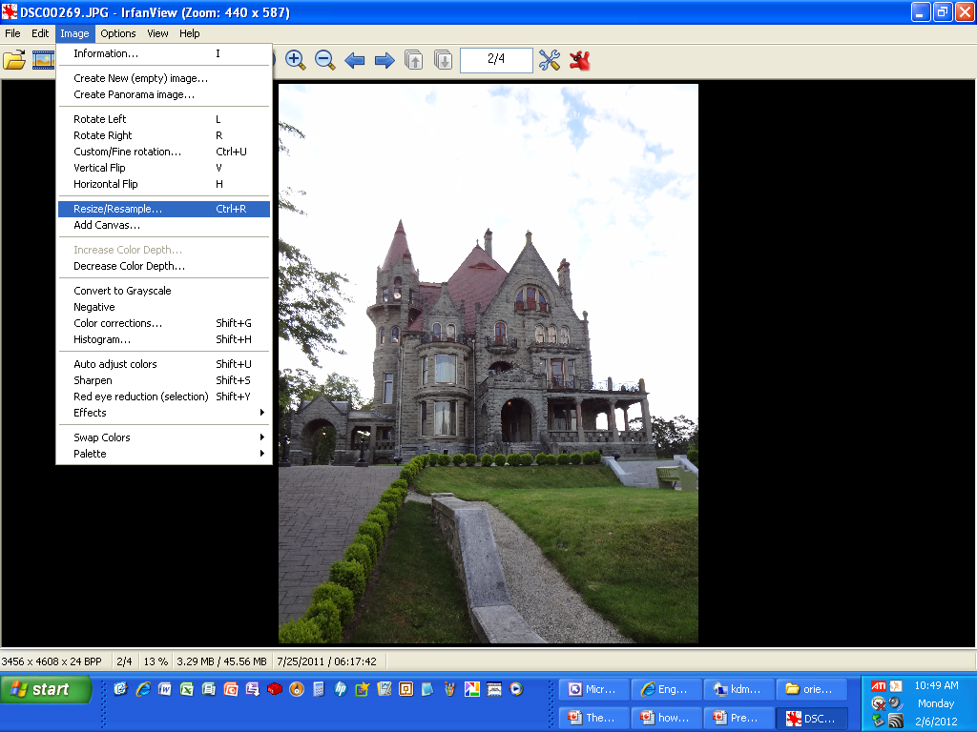
Documenting your work with screen captures
Here you can resize your photo. A good size for most PowerPoints is a width of 600 pixels or so.

